Slide 1
Springboard Data Science Capstone 3
Cole Romanyk

Slide 2


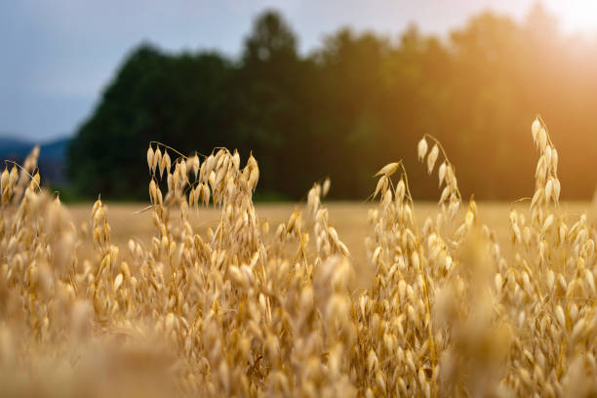
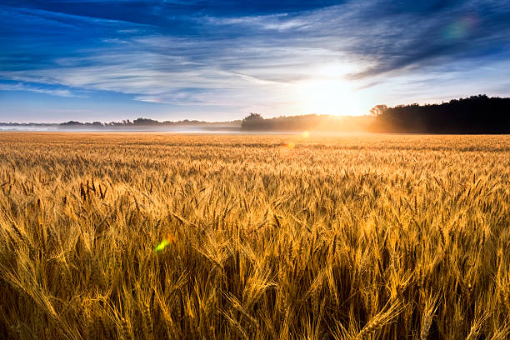
Problem
Classify in field crop from remote sensors
Prime Agri entering a new market
Multiclass model:
Roc_auc success metric
90%
Notes:
Train a model that can classify in field crops from remote sensing data that we can collect from our drone fleet to generate market insights and inform sales decisions/force
Roc_auc because classes will be balanced via SMOTE, and must maximize TP while minimize FN because we do not offer seeds for every crop in the dataset and travel costs for salesmen are covered by company.
Minimum target goal score of at least 90%

Slide 3

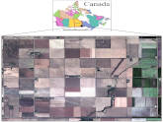
Data Sources
UCI Machine Learning library
Remote sensing data
Notes:
Collection of satellite imaging and POLsar sensor data collected from fields in Winnipeg Canada

Slide 4
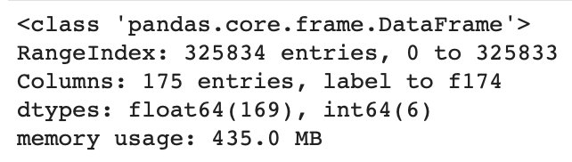
Wrangling
Missing data
Feature types
Feature Names
Notes:
The dataset contained no missing values
The dataset consisted only of continuous numerical measurements
Feature names were missing (originally listed as f1-f174), had to scrape the feature names from the UCI website and append them to the DataFrame columns attribute.

Slide 5
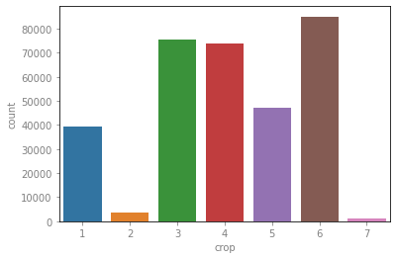
EDA
325,834 observations and 174 features
High dimensionality
Class imbalance
Corn - 1 | Peas - 2 | Canola - 3 | Soybeans - 4 | Oats - 5 | Wheat - 6 | Broadleaf - 7
39,162 | 3,598 | 75,673 | 74,067 | 47,117 | 85,074 | 1,143
Notes:
Key concerns with this dataset:
Curse of dimensionality – so many features that makes the feature space so sparse and the model will not be able to generalize to trends in data as a result.
Significant level of class imbalance – broadleaf and pes categories make up less than 2% of total observation.
Broadleaf is a term that refers to several different species of field crop, including corn a soybean.

Slide 6
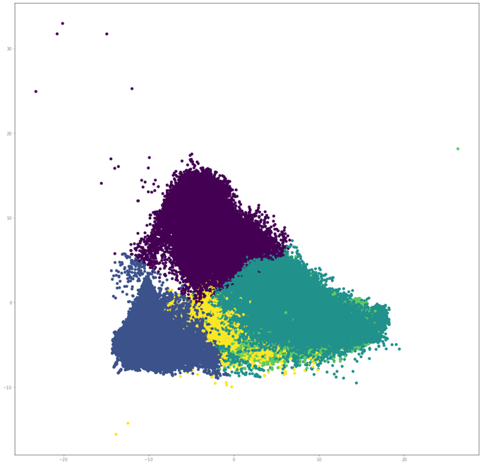
Preprocessing the Data
handling the Class Imbalance
Broadleaf
SMOTE
Dimensionality Reduction
Kmeans Clustering
PCA
Notes:
Drop the broadleaf class all together
SMOTE was chosen as the preferred method to balance the classes, because it can increase sample size without duplicating observations.
returns a perfectly balanced dataset in regards to class representation, this is a major concern when choosing to use Roc_Auc as the scoring metric because outliers from minority classes punish negative predictions heavily (train test split was done prior to this synthetic growth technique, to prevent leakage).
Unsupervised techniques were unable to accurately split the oat and wheat classes, and in order to preserve the information of every feature PCA was chosen to reduces the number of feature to the 90% of explained variance threshold.

Slide 7
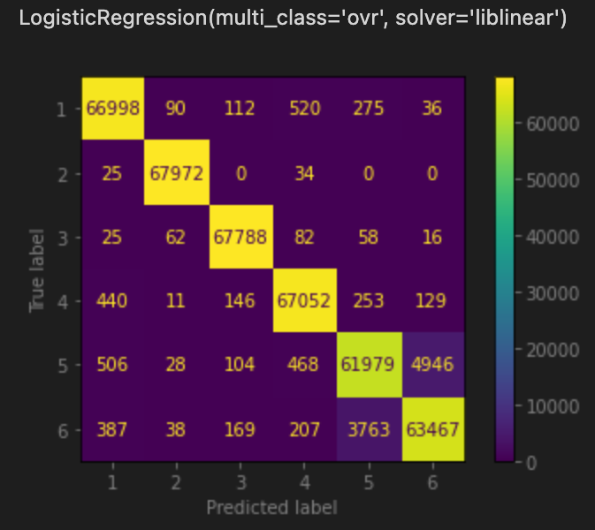
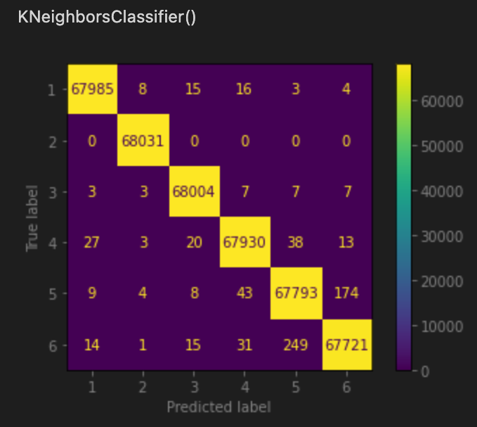
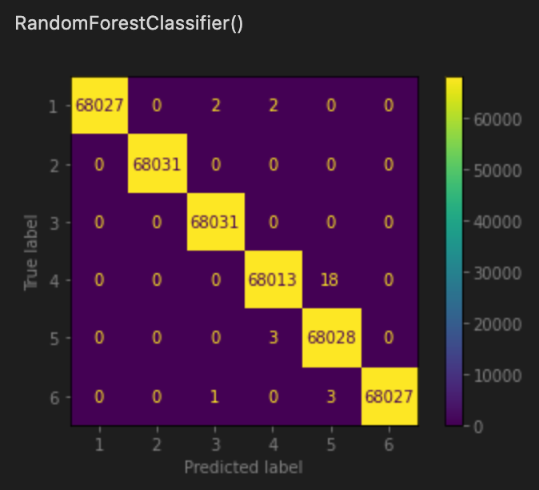
Models Selection
Logistic Regression
Preliminary score: 0.9682
Fit/score time: 36.5 sec
K Nearest Neighbors
Preliminary score: 0.9982
Fit/score time: 74 min 27 sec
Random Forest Classifier
Preliminary score: 0.9999
Fit/score time: 3 min 41 sec
Notes:
Logreg fastest but least accurate on test set
KNN exorbitantly long run time, 2nd best prelim score
RF fast enough for field use, and by far the most accurate
even after cross validation the RF model remains the most generalizable of the 3 models.
should be noted that a trained logreg model maybe be beneficial for providing real time insights out in the field due to speed and relative accuracy on cv 0.9962.

Slide 8
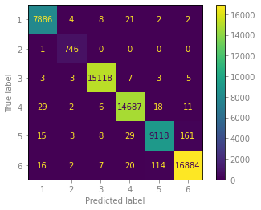
Test Set Results
Extremely accurate on test data
Roc_Auc score of .99986
No hyperparameter tuning
Simplicity and Efficiency
Notes:
The default values predict crop class nearly perfectly, no need for extra time spent tuning hyperparameters.
The model is both simple and efficient, training a neural network is both time consuming and computationally expensive.
this model can achieve extremely accurate predictions in just a few minutes, and can easily be adapted to new data.
Because of the easy of training an deploying more time can be spent interpreting the results of the model

Slide 9
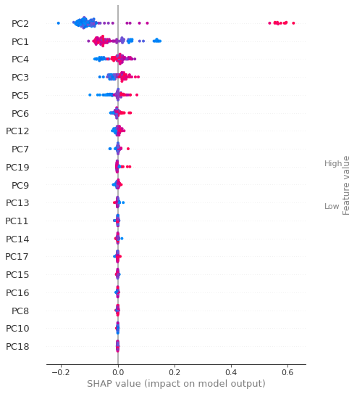
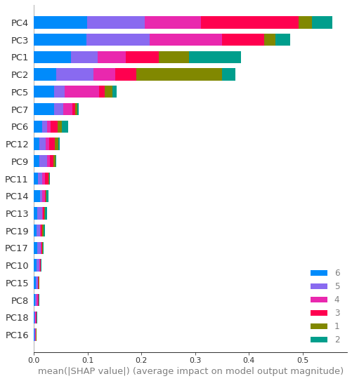
Shap Values
Global Explicability
How influential is each PC on class prediction
Local Explicability
What are the top PC’s for each class
Are the effects positive or negative
Crop | Corn | Peas | Canola | Soybeans | Oats | Wheat
Shap 1 | PC2 | PC1 | PC4 | PC3 | PC3 | PC4
Shap 2 | PC1 | PC4 | PC3 | PC4 | PC4 | PC3
Shap 3 | PC4 | PC3 | PC1 | PC5 | PC2 | PC1
Notes:
Top global – PC4, PC3, PC1, PC2
PC4 and PC3 most important in distinguishing between classes even though they are 3rd and 4th in explained variance (eigen value), when looking at local values there is a great deal of variation in shap value spread for class 4 among the different classes.
PC4 almost always in top 3 of shap values for each class
Local (Corn) – PC2 most important in predicting corn, despite PC4 being the most powerful globally
PC1 is second, high values decreasing corn prediction and low values increasing it

Slide 10
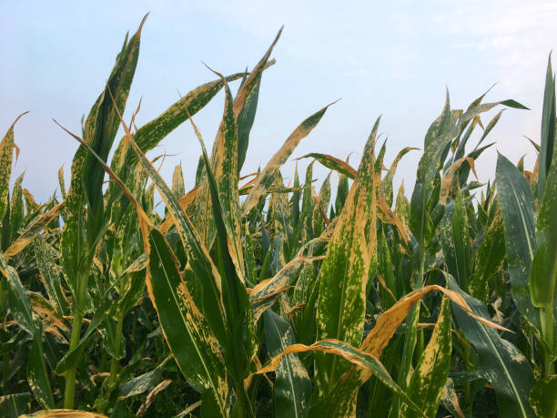
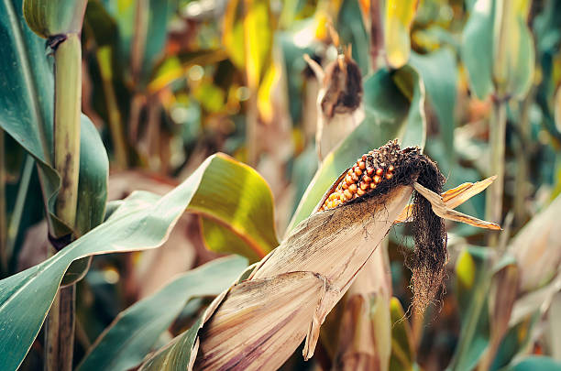
Future Improvements
Hyperparameter tuning
LogReg
Neural Network
More Crop Species
Detect Disease and Pest Spread
Notes:
Hyperparameter tuning though computational costly and time consuming could yield more accurate classifications
It would be particularly interesting to see how well a tuned LogReg function can perform, its speed combined with increased accuracy could be extremely beneficial for real time in field predictions
Training a Neural network could also lead to more accurate results
Instead of a Other or Broadleaf class, sensor data from more crop species could be included to broaden the predictive ability of the model to unseen crop varieties
Potentially expand training data to distinguish diseased from healthy crops.

Slide 11
Thank You
UCI and Dr. Iman Khosravi for posting and allowing use of the dataset.
Istockphoto.com for stock field crop pictures
Big thank you to Wei (Wayne) Ang, without your constant help and guidance this capstone would not have been possible!

